Slide 1
Shell Scripting

Slide 2
What is Shell ?
The user interface to the operating system.
Functionality:
Execute other programs
Manage files
Manage processes

Slide 3
What is Shell Script ?
A shell script is a computer program designed to be run by the Unix shell, a command-line interpreter.
A shell script is a regular text file that contains shell or UNIX commands.
Typical operations performed by shell scripts include file manipulation, program execution, and printing text.

Slide 4
Types of Shells
Shell | Path | Default Prompt (non-root user) | Default Prompt (Root user)
The Bourne Shell (sh) | /bin/sh and /sbin/sh | $ | #
The C Shell (csh) | /bin/csh | % | #
The Korn Shell (ksh) | /bin/ksh | $ | #
The GNU Bourne-Again Shell (Bash) | /bin/bash | bash-x.xx$ | bash-x.xx#

Slide 5
How to write Shell Script
Script must begin with #! (pronounced “shebang”) to identify shell to be executed.
Examples:
#! /bin/sh (defaults to bash)
#! /bin/bash
#! /bin/csh
#! /usr/bin/tcsh
Make the shell program executable :
- Use the “chmod” command to make the program/script file executable

Slide 6
Defining a variable name
The name of a variable can contain only letters (a to z or A to Z), numbers ( 0 to 9) or the underscore character ( _).
you cannot use other characters such as !, *, or - because these characters have a special meaning for the shell.
(Variable name) → Name = “ABC” ← (Value)
all the scripts would have the ”.sh” extension. Before you add anything else to your script, you need to alert the system that a shell script is being started. This is done using the shebang(#!) construct.

Slide 7
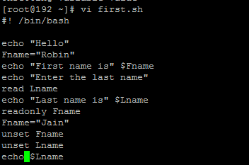
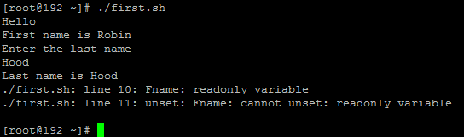
Example : # Script # Output

Slide 8
Arrays
Shell supports a different type of variable called an array variable. This can hold multiple values at the same time.
We can use single array variable to store the multiple values.
Syntax : array_name[index] = value
Accessing array values : ${array_name[index]}

Slide 9
Shell decision making
Shell supports conditional statements which are used to perform different actions based on different conditions.
--The if...else statement
--The case...esac statement
In if…else statement we have following forms :
if…fi statement
if…else…fi statement
if…elif…else…fi statement

Slide 10
SHELL loops
A loop is a powerful programming tool that enables you to execute a set of commands repeatedly.
-- The while loop
-- The for loop
-- The until loop

Slide 11
THANK You !!

